Slide 1
Comb Sort

Slide 2
Review other sorts
Bubble sort
how bubble sort changes an array?
Quick sort
how quick sort changes an array?

Slide 3

What is that
The Comb Sort is another comparison and exchange sort which builds on the idea of the Bubble Sort

Slide 4
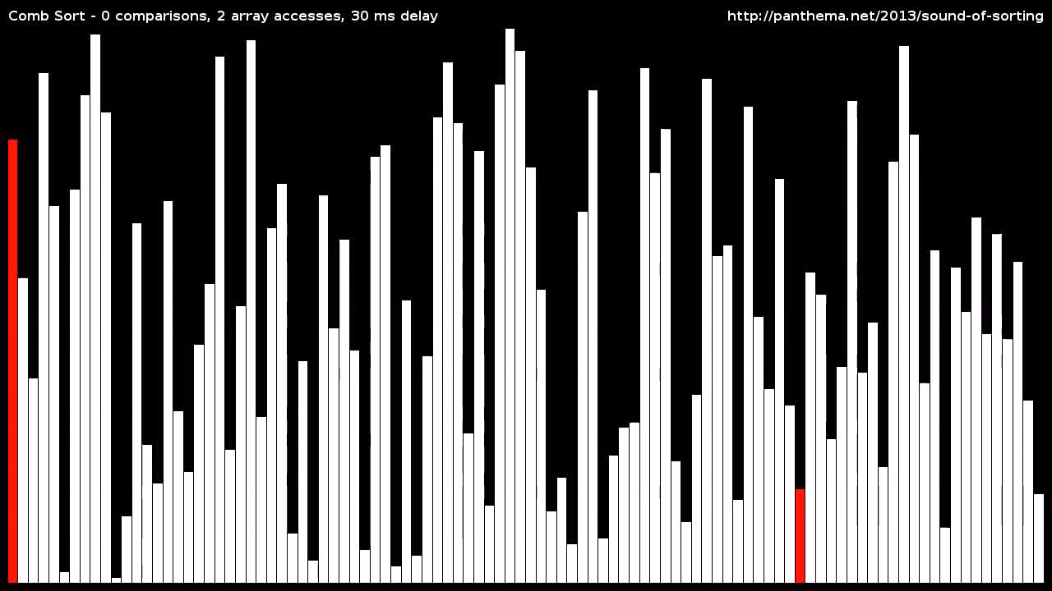
How it works

Slide 5
Common Terms
Turtle - a name given to small numbers that appear towards the end of a data set. When used in a Bubble Sort, small numbers at the end of the set take a very long time to get to the front of the list, and hence are called turtles because of the lack of speed.

Slide 6
Each iteration of the algorithm consists of three stages:
Calculation of the gap value.
Iterating over the data set comparing each item with the item that is “gap” elements further down the list and swapping them if required.
Checking to see if the gap value has reached one and no swaps have occurred. If so, then the set has been sorted.

Slide 7
How to calculate the gap
The gap, which is essentially an offset used when comparing elements, is something that changes for each iteration. The value needs to change in a uniform manner in such a way as to provide optimum comparisons during the sorting phases.
calculation of the gap is as simple as starting with the size of the data set and dividing by a factor of 1.3 each iteration.

Slide 8
Iterating and Swapping
This phase is the same as the Bubble Sort. The only difference in the Comb Sort is that the items which are compared are i and i + gap as opposed to i and i + 1.
For each iteration, we start at the beginning of the data set and loop until i + gap is greater-than or equal to the size of the data . For each sub-iteration in this loop, we compare i and i + gap and swap the values if required.

Slide 9
64
28
44
10
99
1
-1
Gap = 6

Slide 10
-1
28
44
10
99
1
64
Gap = (int)6 / 1.3 = 4

Slide 11
-1
1
44
10
99
28
64
Gap = (int)4 / 1.3 =3

Slide 12
-1
1
28
10
99
44
64
Gap = (int)3/ 1.3 = 2

Slide 13
-1
1
28
10
64
44
99
Gap = (int)2/ 1.3 = 1

Slide 14
-1
1
10
28
44
64
99
Gap = 1

Slide 15
Pseudocode
using the length/size of the set as the gap.
do the comb sort with the current gap
reset the gap value so that it shrinks(1.3)
in order the card

Slide 16



Big O notation in the best/worst/average case
Worse case | Best case | Average case
$$Ο(n^{2})$$
$$\left.Θ(n log n\right)$$
Ω($n^{2}$/$n^{p}$)

Slide 17
Thank you for watching

